Slide 1
HOW TO INSTALL TYPE4 DRIVER AND INSIDE CACHEDROWSETIMPL
Masanori Kawai Aptech
16/Aug/2010

Slide 2
Type1(JDBC-OBDC Bridge)
1. Class.forName("sun.jdbc.odbc.JdbcOdbcDriver");
2. Connection con = DriverManager.getConnection(
"jdbc:odbc:JAVADSN","kawai","123");
In 1, Command for JVM to load the specific package(sun.jdbc.odbc.JdbcOdbcDriver).
In 2, Get the interface of the Database connection for specifying the ODBC parameter.

Slide 3
What is disadvantage of type1?
The total performance strongly depends on ODBC performance.
Some databases(OpenOffice Base, Early Apache DB) does not support ODBC connectivity.
Let’s get Type 4 driver of MS SQL 2005.

Slide 4
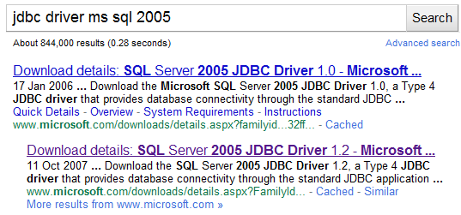

Download type 4 driver of SQL2005

Slide 5
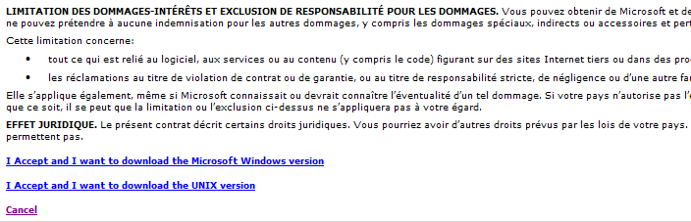
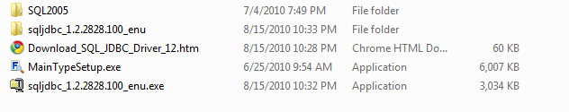
Download type 4 driver of SQL2005

Slide 6
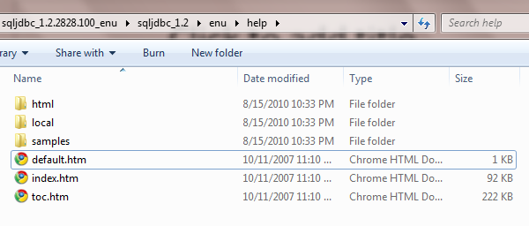
Check how to use it!!

Slide 7
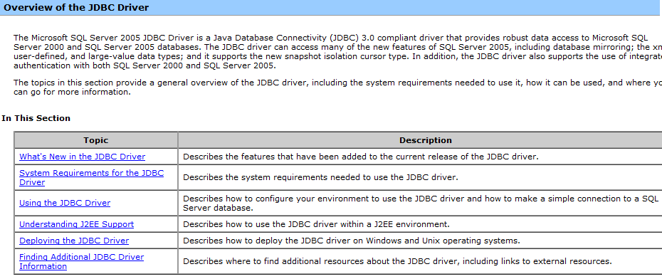
Check how to use it!!

Slide 8
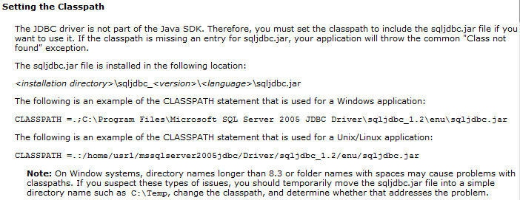
Check how to use it!!

Slide 9
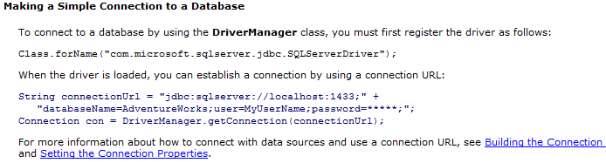
Check how to use it!!

Slide 10
Type4(Pure Java Driver)
1. Class.forName("com.microsoft.sqlserver.jdbc.SQLServerDriver");
2. Connection con = DriverManager.getConnection(
"jdbc:sqlserver://192.168.1.47:1433;databaseName=AdventureWorks;user=kawai;password=123;");
In 1, Command for JVM to load the specific package(com.microsoft.sqlserver.jdbc.SQLServerDriver).
In 2, Get the interface of the Database connection for specifying the MS SQL2005 parameters.

Slide 11
What is Cache?
Cache is not technology, it is a sort of technique for improving performance and tolerance.
Cache is collections of temporary data.
There are many kinds of cache technique.
For example……

Slide 12
Tire 3 model
lost
User: Web Browser
AP Server
JVM running
DB Server
SQL2005 running
When the connection lost between AP and DB servers happen, if AP servers do not have any data, users can NOT continue to use their services.

Slide 13
Tire 3 model
lost
User: Web Browser
AP Server
JVM running
DB Server
SQL2005 running
However, if AP servers make a cache from DB server, user CAN continue to use their services.

Slide 14
Cache is very useful. However….
How to implement the cache?
Generally, it is better to extend the implemented class of ResultSet.
  Because this class maybe have the same interface and share the similar function.
But, The implemented class is hidden.(private)
Also, we want to reuse these CachedRowSet implemented class as Component.
  What should I do…..

Slide 15
Why is ResultSet only interface?
The implemented object of ReusltSet is hidden.
  When JDBC 1.0(J2SE 1.3) was introduced, there were many sorts of DBMS.
  SUN only considered the needed features for executing SQL statement on JAVA.

Slide 16
Why is ResultSet only interface?
  In these cases, they had to choose the hidden implement object, because if users can access implement object, there were possibilities in which uses used the vendor dependent methods.
  JVM vendors are not only SUN. (IBM, Apple , and Apache and so on, they also have their own JVM.)

Slide 17
New interface(RowSet) appeared
RowSet is a kind of JavaBean interface.
  What is JavaBean?
    JavaBean is the name for Java Component Model.
    What is Component Model?
      Collections of rules for using external objects.
      What is different between Object Oriented and Component Model?
        Object Orient defines how to describe objects.
        Component Model defines how to use objects(components)
        Next semester

Slide 18
OK, who should implement it?
Basically, AP server vendor, otherwise DB server vendor should implement it.
In these cases, SUN prepares the Reference Implementation.(RI)
Who decides class names and method names of this package? Is it SUN?
  No, Java Community Process.
    What is Java Community Process?

Slide 19
Java Community Process(JCP)
Though SUN invented Java Technology, if SUN only decided APIs , other vendors can not provide comments publically.
and ,so SUN established third organization to make a decision for Java APIs.
The organization is JCP. (http://www.jcp.org)

Slide 20
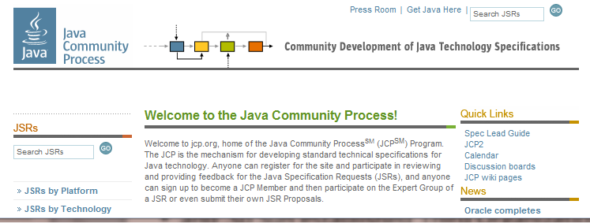
Home Page of JCP

Slide 21
Java Specification Request(JSR)
JCP makes a group for requesting APIs.
This group is called Java Specification Request(JSR)
For example, CachedRowSetImpl is defined by JSR 114.
Do all JSRs become Standard APIs?
  No, The only JSRs which JCP approved will become Standard APIs.

Slide 22
Java Specification Request(JSR)
The package name of JSR 114 is “com.sun.rowset”, “com.sun.rowset.providers” which indicate that these are not Standard.(In case of Standard APIs, the head of name should be java or javax)
JVM vendors are not only SUN, and other vendors may not have this package.

Slide 23
Definition of CachedRowSetImpl
public class CachedRowSetImpl extends BaseRowSet
implements RowSet, RowSetInternal, Serializable, Cloneable, CachedRowSet {
……..
// Save cache data in Vector.
private Vector rvh;

Slide 24
Constructor
public CachedRowSetImpl(Hashtable env) throws SQLException {
…
initContainer();
}
private void initContainer() {
// allocate a hundred of elements at initiation.
rvh = new Vector(100);
……
}

Slide 25
Create cache data from ResultSet
public void populate(ResultSet data) throws SQLException {
// get the meta data for this ResultSet RSMD = data.getMetaData();
// set up the metadata initMetaData(RowSetMD, RSMD);
// continue…..

Slide 26
Create cache data from ResultSet
// copy records from ResultSet to rvh
while ( data.next()) {
// Create currentRow object with the number of colums
currentRow = new Row(numCols); ….
for ( i = 1; i <= numCols; i++) {
// Get objects data from ResultSet.
obj = data.getObject(i);
// Set objects into the Row object
((Row)currentRow).initColumnObject(i, obj);
}
// Add currentRow object into private rvh
// (This is cached data.)
rvh.add(currentRow);
}

Slide 27
THANK YOU FOR YOUR ATTENTION

